Slide 1
Bacteria
Class Teacher
Dr. Hannan Mukhtar
Assistant Professor
Department of Botany
Lahore College for Women University, Lahore Pakistan.
Course Description
Course Title: DIVERSITY OF PLANTS
Course code: Min/Bot-102
Credit hours: 4 (3+1)
Class
Course : BS I, 2nd Semester
Major: Zoology
Minor course: Botany

Slide 2
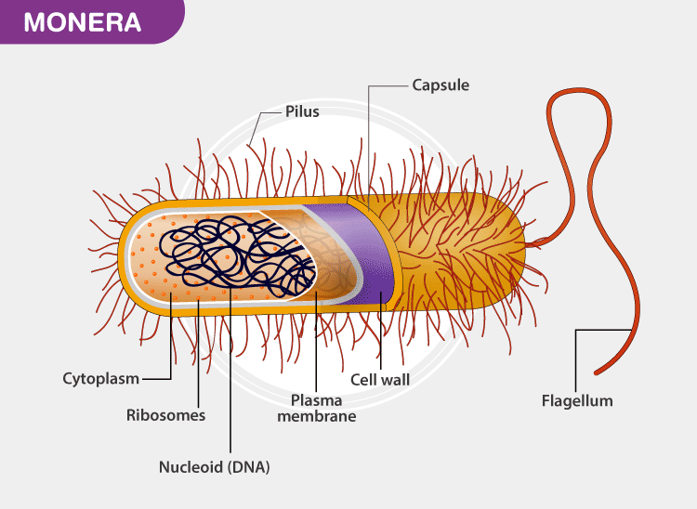
Bacteria
General Characters

Slide 3
Characteristics of Bacteria
The Monerans are unicellular organisms/Prokaryotes
They contain 70S ribosomes.
The DNA is naked and is not bound by a nuclear membrane.
It lacks organelles like mitochondria, lysosomes, plastids, Golgi bodies, endoplasmic reticulum, centrosome (all menmbrane bounded organelles)
They reproduce asexually by binary fission or budding.
The cell wall is rigid and made up of peptidoglycan.
Flagella serves as the locomotory organ.
These are environmental decomposers and mineralizers.
They show different modes of nutrition such as autotrophic, parasitic, heterotrophic, or saprophytic.

Slide 4
Evolution of Bacteria
Bacteria first arose on Earth approximately 4 billion years ago,
They were the first forms of life on Earth.
For 3 billion years, bacteria and archaea were the most prevalent kinds of organisms on Earth.
Multicellular eukaryotes did not appear until around 1.6-2 billion years ago.
Eukaryotic cells, which make up all protists, fungi, animals, and plants, also contain what was once bacteria;
It is thought that the mitochondria in eukaryotes, which produce energy through cellular respiration, and chloroplasts in plants and algae, which produce energy through photosynthesis, both evolved from bacteria that got taken up into cells in an endosymbiotic (mutually benefiting) relationship that became permanent over time.

Slide 5
Structure of Bacteria
A prokaryotic cell has five essential structural components: a nucleoid (DNA), ribosomes, cell membrane, cell wall, and some sort of surface layer, which may or may not be an inherent part of the wall.
Structurally, there are three architectural regions: appendages (attachments to the cell surface) in the form of flagella and pili (or fimbriae); a cell envelope consisting of a capsule, cell wall and plasma membrane; and a cytoplasmic region that contains the cell chromosome (DNA) and ribosomes and various sorts of inclusions

Slide 6
Shapes of Bacteria

Slide 7
Flagella in Bacteria

Slide 8
Mode of nutrition in bacteria

Slide 10
Binary fission in bacteria (Asexual reproduction) in bacteria

Slide 11
Sexual reproduction in bacteria

Slide 12
Transduction in Bacteria

Slide 13
Transformation in bacteria

